Slide 1
Computerization of College Admission Predictor
Submitted to: Submitted By:
Ms. Shiwani Garg Ridhima Aggarwal 101510064
Shaunak Arora 101510074
Siddarth Aswal 101510082
Megha Arora 101690007
(CML 4 , GROUP 7)

Slide 2
INTRODUCTION
This project “Computerization of College Admission Predictor” is a web based application where student can register with their personal as well as marks details for predicting the admission in colleges.
The college predictor results and analysis can be downloaded in the form of a personalized report.
This application will contain the information about the previous year cut offs and the eligibility criteria’s of various colleges.

Slide 3
OBJECTIVES
It helps students to get the list of colleges to which they can apply as the system shortlists the colleges by comparing the student’s marks and college's cut off.
Admin manages all the system related task such as:
adding college details,
specifying cut-off details,
managing college details,
viewing student’s details
viewing feedback from registered students.

Slide 4
BACKGROUND OF THE RESEARCH TOPIC
Various students have no idea which college they can be eligible for after their 12th standard due to which many don’t fill the required forms whereas others spend a lot of money for the forms of certain colleges they won’t get selected for. Through this the students can have a rough idea about which college they can get so they can filter out the colleges effectively.

Slide 5
METHOD OF STUDY:
The analysis procedure comprised of going through the websites of various colleges
The college’s past student intake.
The previous cut offs
The past trend in JEE ranks.
The number of students applying every year in the past five years.
The ranking of the colleges

Slide 6
ADVANTAGES
It helps student for making decision for choosing a right college.
Here the chance of occurrence of error is less when compared with the existing system.
It is fast, efficient and reliable.
Avoids data redundancy and inconsistency.
Very user-friendly.
Easy accessibility of data

Slide 7
LIMITATIONS
Required active internet connection.
System will provide inaccurate results if data entered incorrectly.

Slide 8
PROPOSED MODEL
In our proposed model, Administrator can add the college details and he batch details. Using this software, the entrance seat allotment became easier and can be implemented using system. The main advantage of the project is the computerization of the entrance seat allotment process. Administrator has the power for the allotment. He can add the allotted seats into a file and the details are saved into the system. The total time for the entrance allotment became lesser and the allotment process became faster.

Slide 9
CURRENT MODEL
Since the students face a lot of difficulty in finding a college at the time of the admissions, it will be very easy to implement this project into a working model. It will help the students in making decisions for choosing a right college. The difference, however, is that due to less data we are not making admin login pages thus not giving the authority to the admin to delete or change the data. We are for now adding all the database through back end.

Slide 10
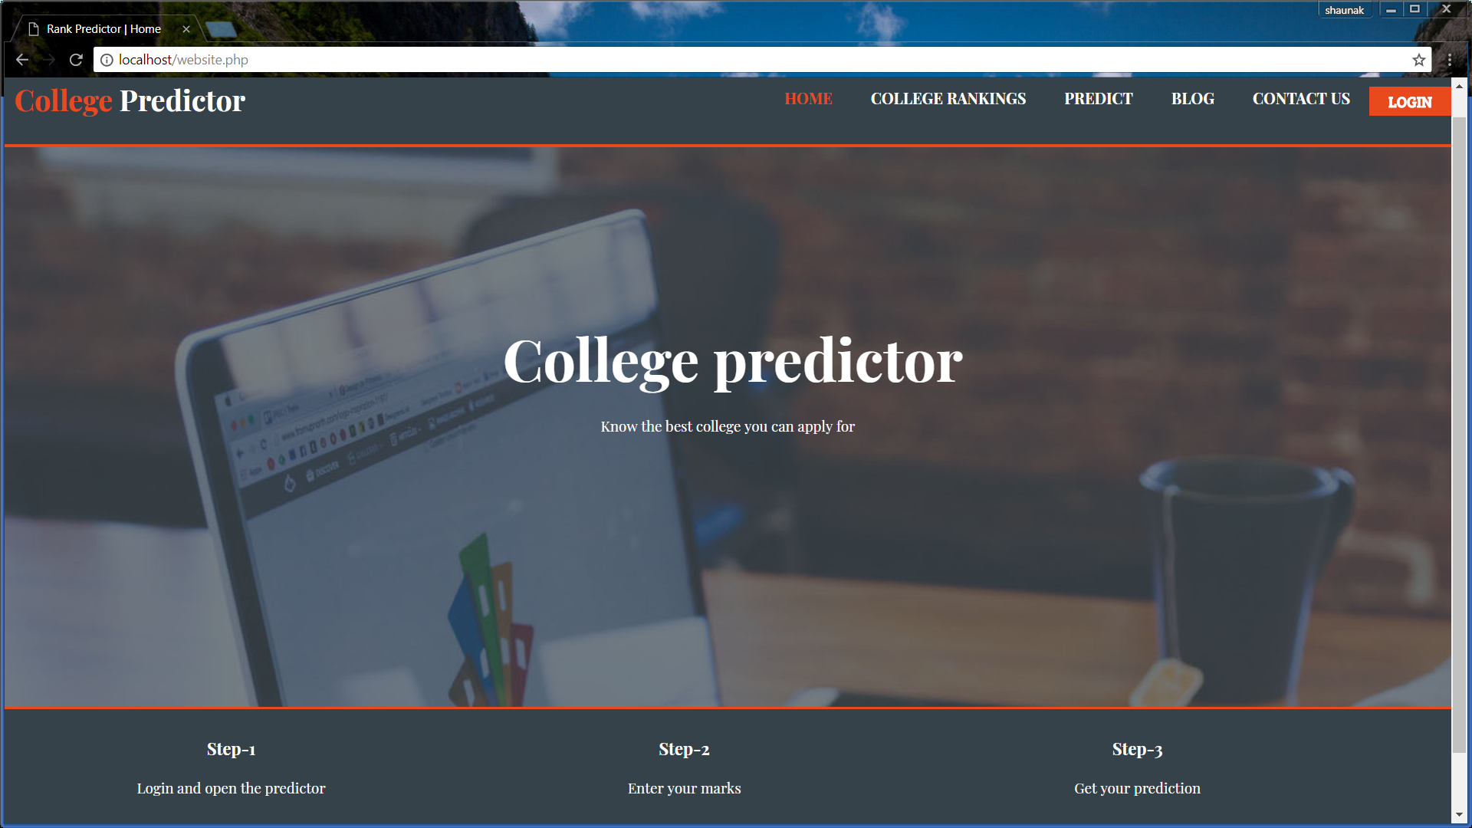
FRONT PAGE OF THE SOFTWARE

Slide 11
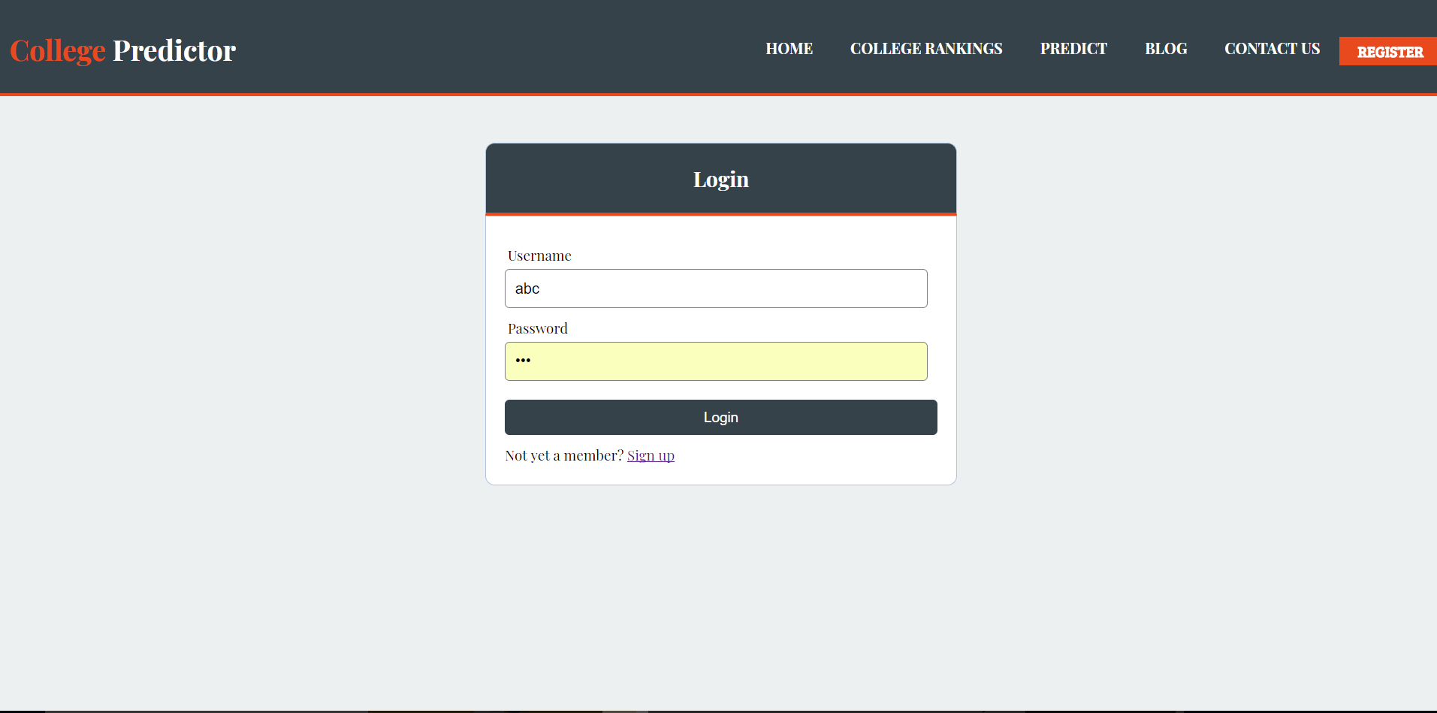
USER LOGIN PAGE

Slide 12
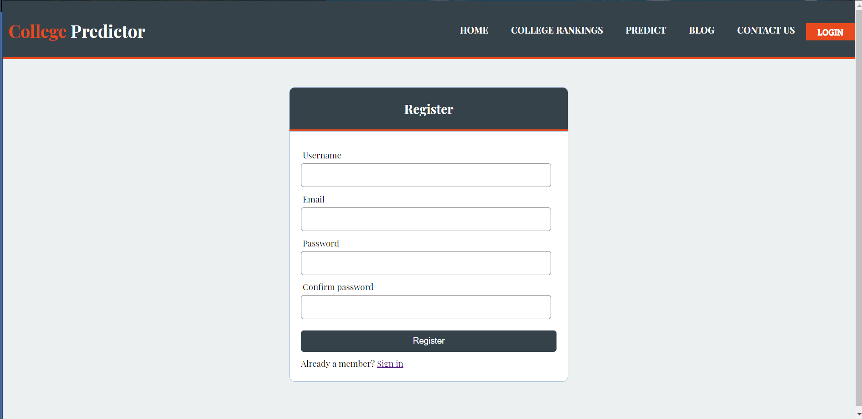

Slide 13
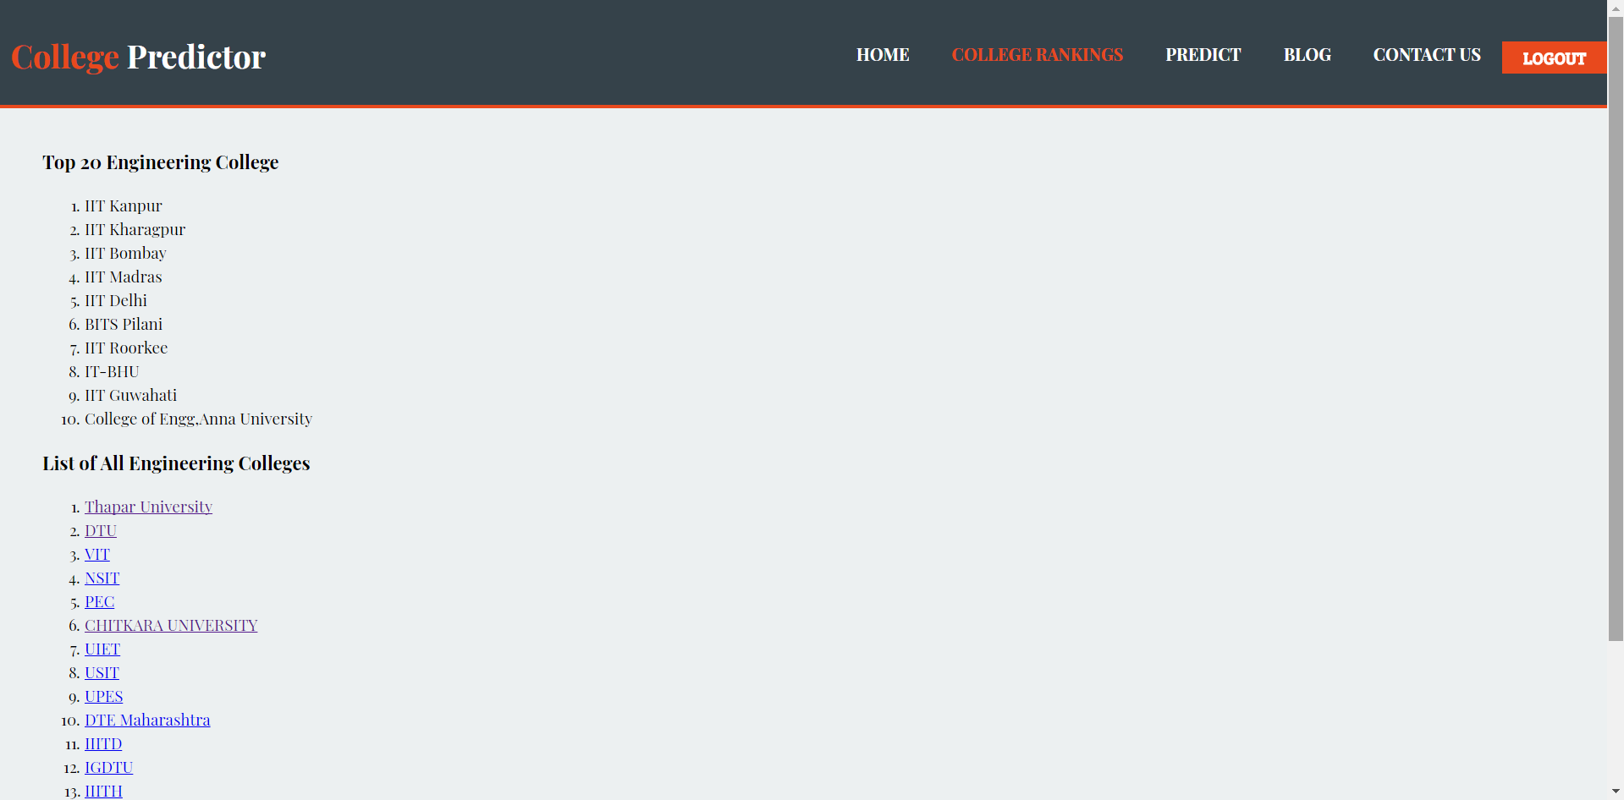
COLLEGE RANKINGS

Slide 14
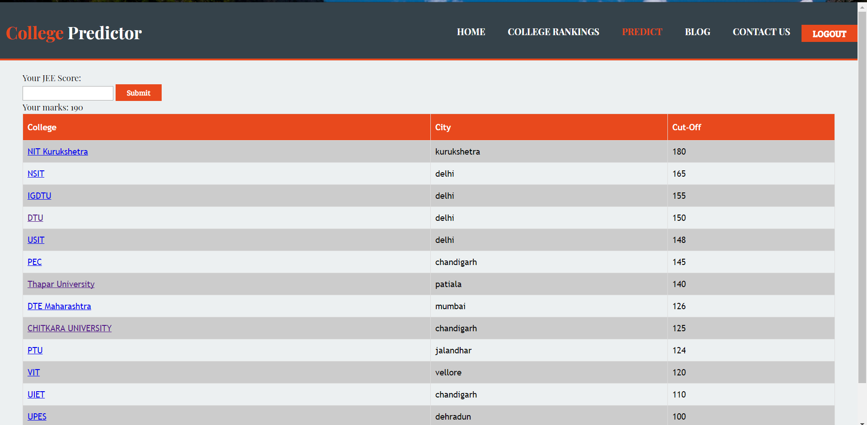

Slide 15
CONCLUSION
The students not only get their overall and preference based results, but also know all the facts about the counselling procedure. This application will contain the information about the previous year cut offs and the eligibility criteria’s of various colleges. So, this application will make it easier for the students to choose the best college for them according to their marks.

Slide 16
THE LINK TO OUR VIDEO:
https://youtu.be/Zm4P1gDOKtg

Slide 17
REFERENCES
Xampp is a software for making local host for the website to work.
Ice cream apps is a software which we used for recording the video.
PHPMYADMIN has been used for storing all our database.

